Slide 1

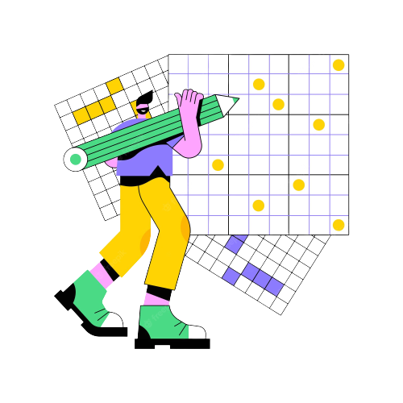
SRM INSTITUTE OF SCIENCE AND TECHNOLOGY FACULTY OF ENGINEERING AND TECHNOLOGY
DEPARTMENT OF DATA SCIENCE AND BUSINESS SYSTEMS
Project Evaluation
SUDOKU SOLVER
Submitted by
SHAIK YASIR TAWFIQ [Reg No: RA2112704010016]
PONNURI ANIRUDDHA [Reg No: RA2112704010015]
Y SHABANYA KISHORE [Reg No:RA2112704010018]

Slide 2
ABSTRACT
At this time, people all over the world are showing an increasing interest in playing puzzle games such as Sudoku. As a result of the game's growing popularity in a great number of countries, numerous game developers have attempted to create conundrums that are both more challenging and more engaging. Today, coverage of the game can be found in a significant number of books, newspapers, and online sources. In this article, we will discuss an algorithm that we have dubbed the "pencil-and-paper algorithm." This algorithm solves Sudoku puzzles by adhering to a few basic rules. The algorithm that is formulated using pencil-and-paper methods is based on human techniques. This indicates that the algorithm is designed with human perceptions in mind before being implemented. Consequently, we've decided to call this solver the pencil-and-paper algorithm. In order to determine whether or not the proposed algorithm is an improvement over the brute-force algorithm, this algorithm is first evaluated and then compared to the brute-force algorithm. The algorithm known as "brute force" is a generic one that can be utilised to solve any issue that may arise. This algorithm will come up with every conceivable solution before it finally settles on the correct one. The problem statement, the reason for doing this project, and the solution to the problem are discussed in the following subsections

Slide 3
LITERATURE SURVEY
Title 1. Sudoku solver using mini grid-based backtracking
(2018)
Sudoku' is a popular Japanese puzzle game that trains our logical mind. The word Sudoku means `the digits must remain single'. The Sudoku problem is important as it finds numerous applications in a variety of research domains with some sort of resemblance. Applications of solving a Sudoku instance are found in the fields of Steganography, Secret image sharing with necessary reversibility, Encrypting SMS, Digital watermarking, Image authentication, Image Encryption, and so and so forth. All the existing Sudoku solving techniques are primarily guess based heuristic or computation intensive soft computing methodology. They are all cell based, that is why very much time consuming. Solving an instance of Sudoku problem is NP-complete. So it is unlikely to develop a deterministic polynomial time algorithm for solving a given Sudoku puzzle of size n×n, where n is any large number such that the square root of n is an integer. But incidentally when the value of n is bounded by some constant, solutions may be obtained in reasonable amount of time. There are quite a few logic techniques that researchers use to solve this problem. Some are basic simple logic, some are more advanced. Depending on the difficulty of the puzzle, a blend of techniques may be needed in order to solve a puzzle. In fact, most computer-generated Sudoku puzzles rank the difficulty based upon the number of empty cells in the puzzle and how much effort is needed to solve each of them. Table 1 shows a comparison chart of the number of clues for different difficulty levels

Slide 4
Title 2. The effect of guess choices on the efficiency of a backtracking algorithm in a Sudoku solver (2017) There are several possible algorithms to automatically solve Sudoku boards; the most notable is the backtracking algorithm, that takes a brute-force approach to finding solutions for each board configuration. The performance of the backtracking algorithm is usually said to depend mainly on two implementation aspects: finding the next available empty cell in the board and finding the options of available legal number that are relevant to the given cell. While these pieces of the backtracking algorithm can vary in efficiency based on their implementation, tests show that the algorithm itself also relies on the statistical distribution of the guesses that it attempts to “plug in” to the board in every given cell. The backtracking algorithm uses an array of the legal numbers in the cell to attempt a solution before it moves on to the next cell. If a solution cannot be found, it backtracks and attempts to solve the board again with a different guess choice. The more errors the solver makes, the more backtracks it must perform, which decreases its overall efficiency and increases its effective runtime. Tests of the solving algorithm were performed using 195 base solutions with multiple initial board configurations were performed to analyze the difference in the algorithm performance by comparing the number of recursive backtracks between sequential and randomly distributed guesses. Analysis show that using values that 11 are given in a shuffled array significantly reduces the number of backtracks done by the solver and, as a result, improve the total effective efficiency of the algorithm as a whole The most noticeable difference between the choices of guesses is the type of solutions that are produced. When the algorithm chooses its guesses in sequential order, the solutions given are deterministic; the same solution - with the same backtracks and recursions - will appear for the same initial board configurations. If the choice of guesses is shuffled, the solutions are varied, and so is the number of recursions and backtracks that the backtracking algorithm performs.

Slide 5
Title3: A Comparative Study on The Performance Characteristics of Sudoku Solving Algorithms (2021) The experimental methodology takes an important role in deciding the fastest algorithm in terms of least time consumption for yielding solution to Sudoku. The algorithms (Brute Force, GA, SA, GRA, HS) discussed in the literature are implemented and test run in an IBM compatible PC with Dual Core Intel processor. The algorithms are fed with a set of 30 randomly chosen Sudoku puzzles from a collection of easy, medium and hard level puzzles. The time taken by each algorithm to solve each puzzle is observed and recorded. The design of such testing environment is set up as the algorithms under consideration have both heuristic and non-heuristic techniques where theoretical analysis only would not serve the purpose of exact performance analysis of these algorithms. The set used to test the algorithms are found to be a good mix of all types of puzzles thereby indicating a good set to judge the ability of algorithms.

Slide 6
EXISTING SYSTEM
Puzzles based on the game Sudoku can be categorized as either an exact cover problem or, more accurately, an exact hitting set problem. Because of this, a sophisticated description of the problem and an effective solution are both possible. "The method of choice for rapid finding [measured in microseconds] of all possible solutions to Sudoku puzzles" is "the method of choice for modelling Sudoku as an exact cover problem and using an algorithm such as Knuth's Algorithm X and his Dancing Links technique." Using Gauss elimination in conjunction with column and row striking is an additional strategy that can be utilized as an alternative. A Brute Force Algorithm is exactly what it sounds like: a straightforward method for solving a problem that relies on sheer processing power and attempting every alternative rather than complicated ways to improve efficiency. These algorithms are called "Brute Force" algorithms. The use of brute-force search is common when the size of the problem is relatively small or when there are problem-specific heuristics that can be applied to decrease the number of possible solutions to a level that is more manageable. The strategy is also employed in situations when the ease of implementation is prioritized over the amount of time it takes.

Slide 7
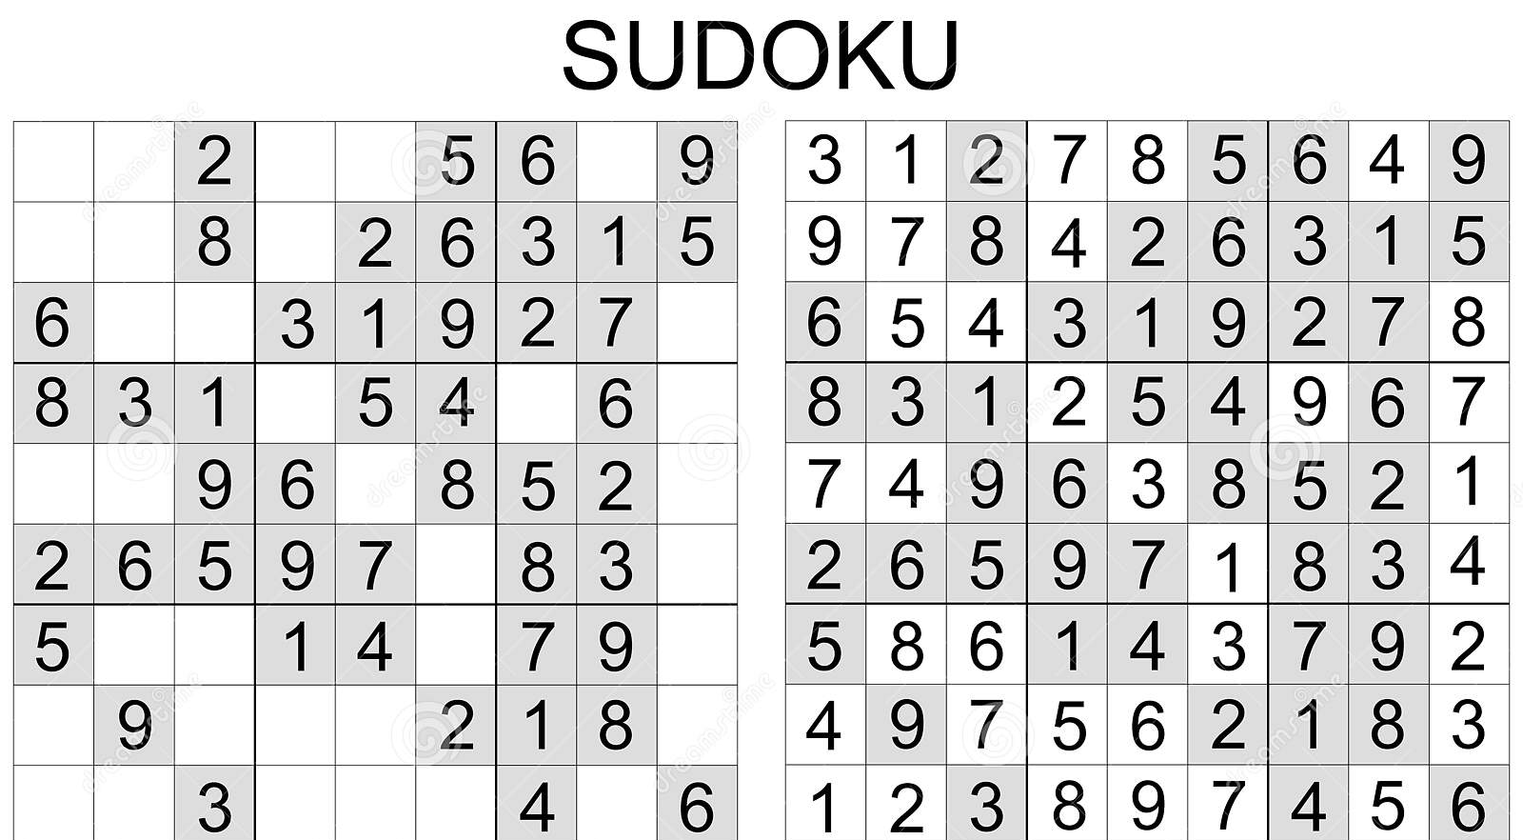
Let Q represent the 9x9 Sudoku matrix, N equal the numbers 1, 2, 3, 4, 5, 6, 7, 8, and 9, and X stand for any row, column, or block in the puzzle. In addition to providing symbols for filling out Q, N also provides an index set for each of the 9 components that make up any X. The elements q that are given in Q are representative of a partial function that goes from Q to N. The answer, denoted by R, is a total relation, and as such, it is a function. Because the rules of Sudoku mandate that the restriction of R to X must be a bijection, any partial solution C that is limited to an X is considered to be a partial permutation of N. If we define T as "X: X is a row, column, or block of Q," then we can say that T contains 27 distinct elements. Either a partial permutation or a permutation on N can serve as the basis for an arrangement. Let Z represent the complete set of arrangements based on N. It is possible to reformulate a partial solution, denoted by the letter C, so that it includes the rules in the form of a composition of relations A (one-to-three) and B that demand compatible arrangements. The solution to the puzzle, as well as suggestions for new q to enter Q, come from prohibited arrangements, which are the complement of C in QxZ helpful tools in the calculus of relations are residual

Slide 8
MODULES
PREPROCESSING
CHARACTER SEGMENTATION
FEATURE EXTRACTION
RECURSION
FINDING EMPTY SLOTS
VALIDITY OF A NUMBER TO BE INSERTED

Slide 9
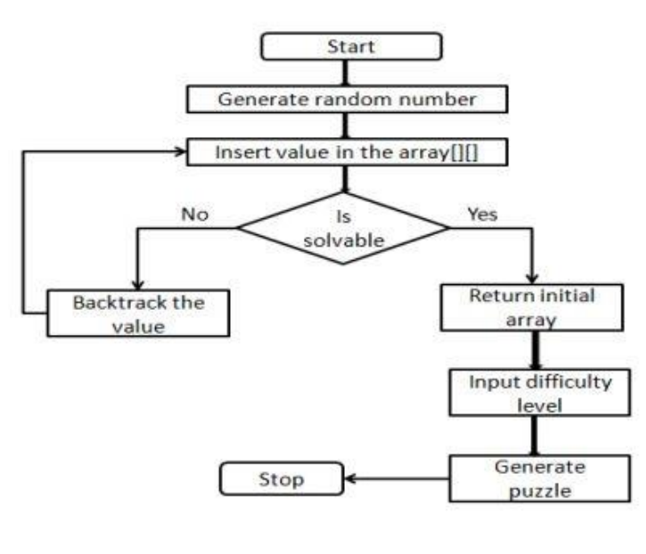
FIGURES AND ILLUSTRATIVE

Slide 10
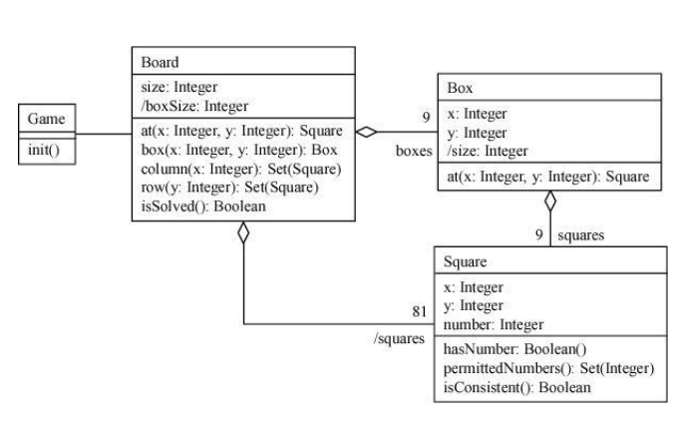

Slide 11
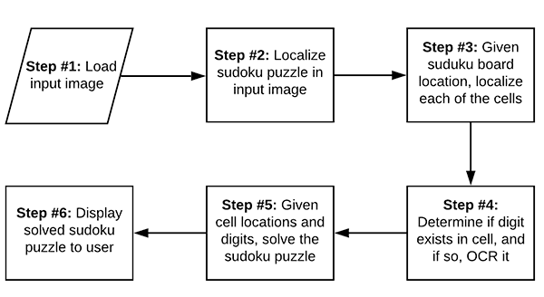

Slide 12

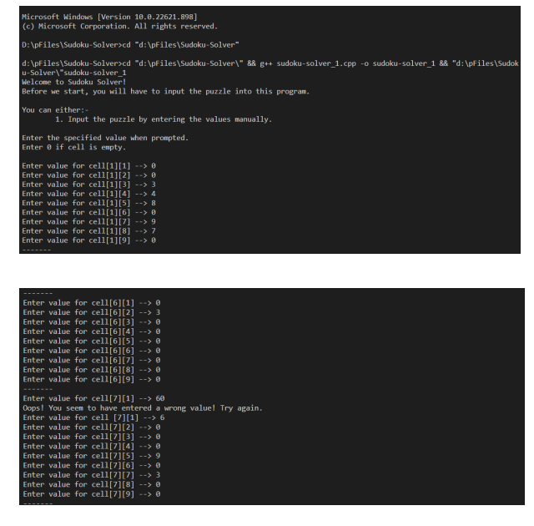
FINDINGS

Slide 13

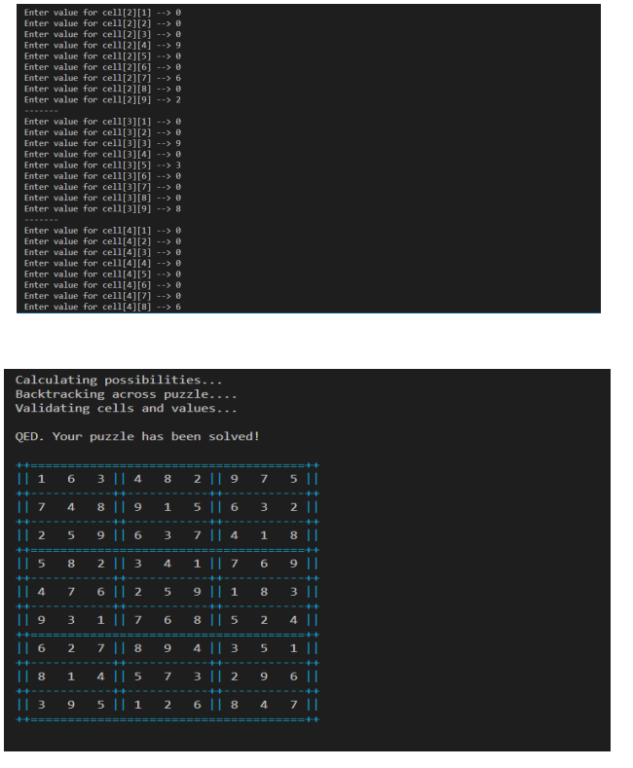

Slide 14
The results of this research indicate that the pencil-and-paper algorithm is a viable strategy that may be used to solve any Sudoku puzzle. In comparison to the brute force approach, the algorithm is a more appropriate method that can find a solution in a shorter amount of time and with greater efficiency. The suggested algorithm is capable of quickly solving such puzzles, regardless of their degree of difficulty, in a relatively short amount of time (less than one second). The results of the tests have shown that the performance of the pencil-and-paper algorithm is superior to the performance of the brute force technique in terms of the amount of processing time required to solve any puzzle. The brute force strategy appears to be a helpful method for solving any and all Sudoku puzzles, and it can ensure the discovery of at least one solution. On the other hand, this technique is inefficient due to the fact that the difficulty level has no bearing on how the algorithm works. To put it another way, the algorithm does not make use of any clever tactics when attempting to solve the riddles. It is a time-consuming process that ultimately results in an inefficient puzzle solver because this algorithm investigates all of the potential answers to the riddle until it finds one that is correct. The most significant benefit of utilising the method is, as has been mentioned previously, the capacity to solve any puzzles, with a solution being absolutely assured to be found
CONCLUSION

Slide 15
Software Requirement :
BASIC C++ COMPILER
APPENDIX: https://github.com/RA2112704010016/DSA_MINI_PROJECT https://github.com/RA2112704010016

Slide 16
THANK YOU

